Slide 1
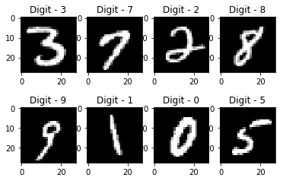

Handwritten Digit Recognition Using Convolutional Neural Networks (CNN) and MNIST Dataset
Mashiath Chowdhury
DEPT: CSE
SEMESTER: 7th
ID: 0562210005101030
Course: Deep Learning Lab
Course Code: CSE-460
Institution: North East University Bangladesh

Slide 2
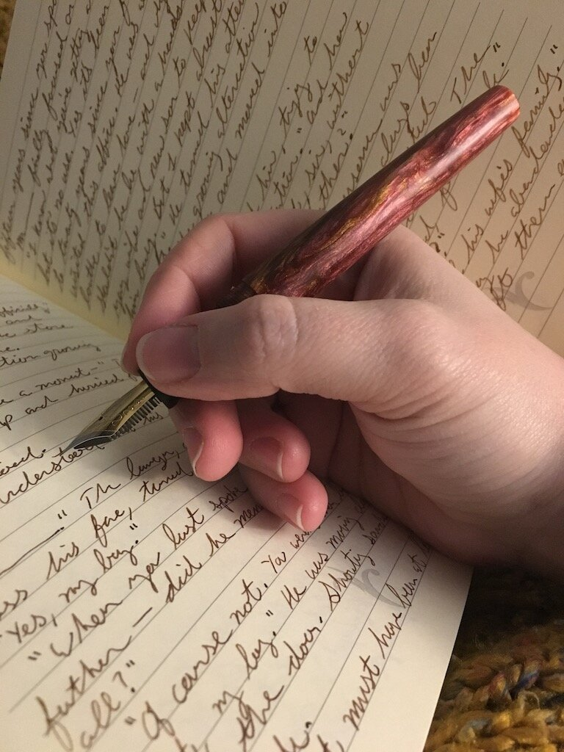
Introduction
Overview
Recognizes handwritten digits (0–9) using a machine learning model
Trained on the MNIST dataset (60,000 digit images)
Built with TensorFlow and Keras
Includes preprocessing for real images (from mobile/camera)
A simple Streamlit app allows image uploads and predictions

Slide 3
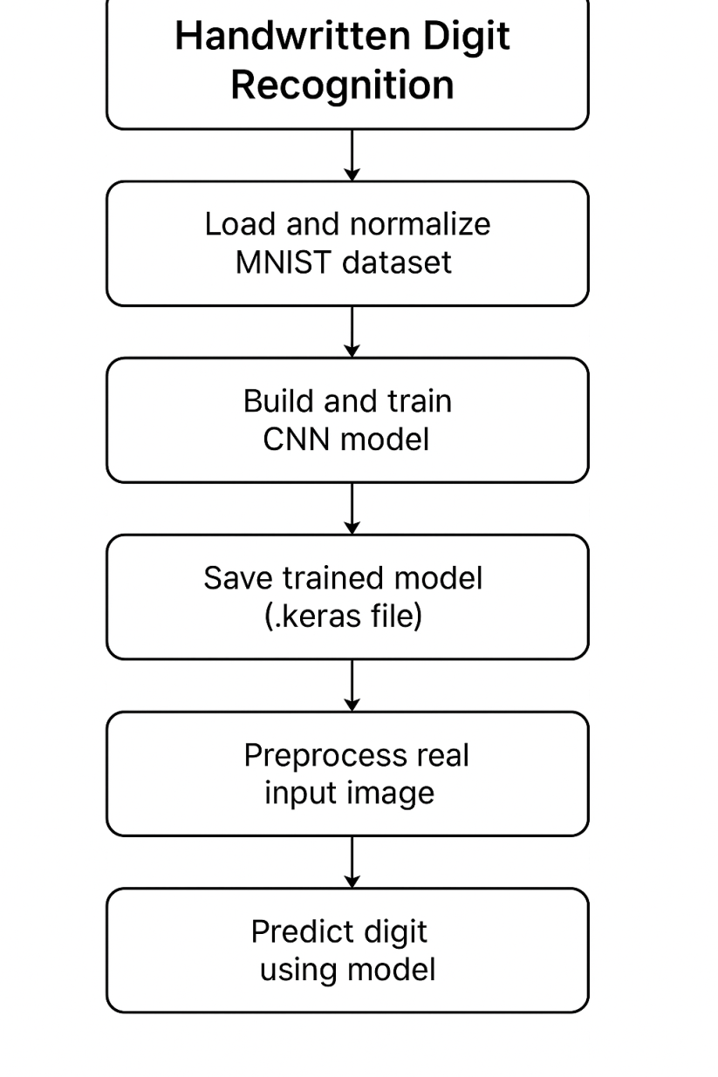
How It Works
FlowChart
Load and normalize MNIST dataset
Build and train CNN model
Save trained model (.keras file)
Preprocess real input image (invert, resize, center)
Use model to predict the digit
Display result using Streamlit

Slide 4
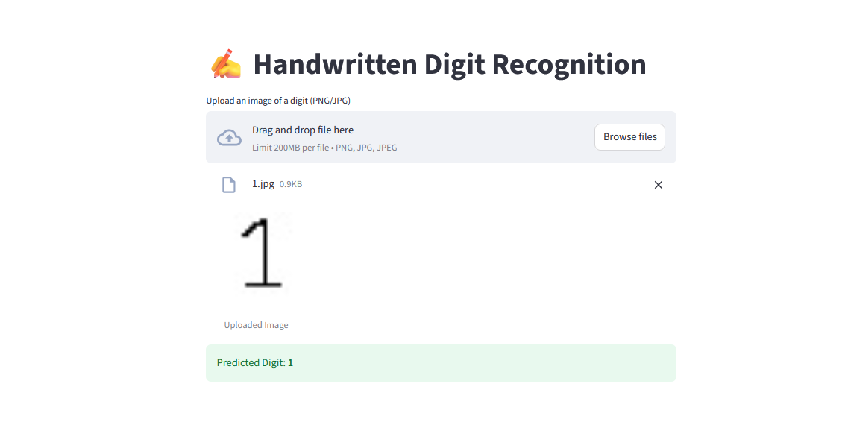
Key Features
Accurate digit prediction with CNN
Supports real-world handwritten images
Web-based app using Streamlit
Easy to use — just upload an image
Clean UI for quick predictions

Slide 5
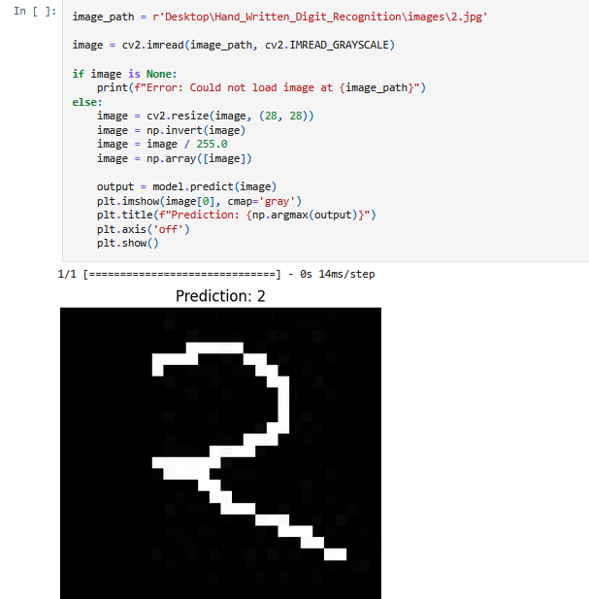
How model works
This is how the model recognizes digits.

Slide 6

Deployment & Future Work
Deployment:
We deployed the trained model using the Streamlit framework, creating an easy-to-use web app that allows users to upload and classify handwritten digit images interactively
Future Improvements:
Incorporate advanced data augmentation techniques to enhance model robustness.
Experiment with deeper or alternative CNN architectures for improved accuracy.
Deploy the application to cloud platforms.

Slide 7
This is how the website looks like

Slide 8
Conclusion
This project successfully demonstrates how deep learning (CNN) can recognize handwritten digits with high accuracy.
The model was trained on the MNIST dataset and adapted to work with real-world images.
A user-friendly Streamlit app makes the prediction process simple and interactive.
This project showcases the practical use of AI in computer vision and is a great starting point for exploring more advanced recognition tasks.

Slide 9
References
TensorFlow. (n.d.). MNIST handwritten digit database. Retrieved from https://www.tensorflow.org/datasets/catalog/mnist
Chollet, F. (2015). Keras. GitHub. Retrieved from https://github.com/keras-team/keras
Streamlit Inc. (n.d.). Streamlit: The fastest way to build data apps in Python. Retrieved from https://streamlit.io
OpenCV Team. (n.d.). OpenCV. Retrieved from https://opencv.org
LeCun, Y., Bottou, L., Bengio, Y., & Haffner, P. (1998). Gradient-based learning applied to document recognition. Proceedings of the IEEE, 86(11), 2278–2324.

Slide 10
Thank you
Any Questions?

